Slide 1
Regressions Analysis
Business Analytics

Slide 2
Linear Regression Model
Regression analysis is one of the most widely used technique in predictive analytics.
Captures the relationship between two or more variables
Predict an outcome of a target variable based on several input variables (e.g., demand based on price, quality, average household income, …)
It shows which of the relationships matter the most.
The variable that should be predicted is called response variable and the input variables are called predictor variables

Slide 3
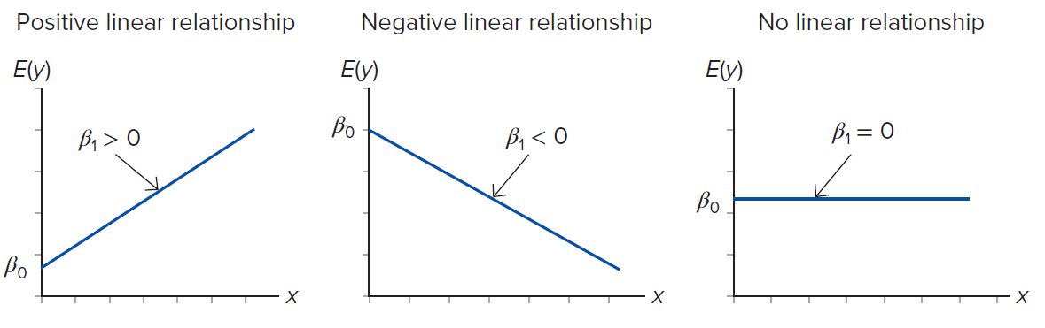
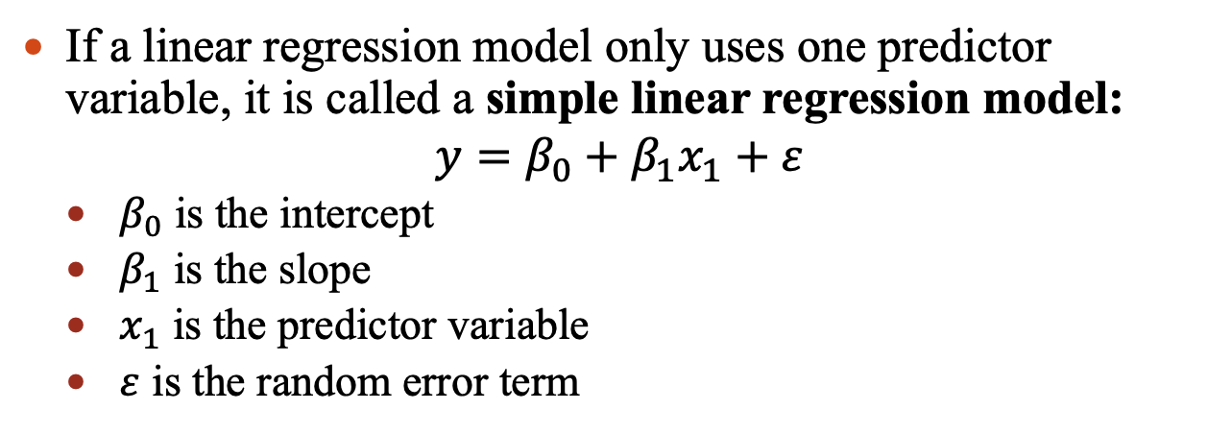
Linear Regression Model
If a linear regression model only uses one predictor variable, it is called a simple linear regression model:
$$y=β_{0}+β_{1}x_{1}+ε$$
$β_{0}$ is the intercept
$β_{1}$ is the slope
$x_{1}$ is the predictor variable
$ε$ is the random error term

Slide 4
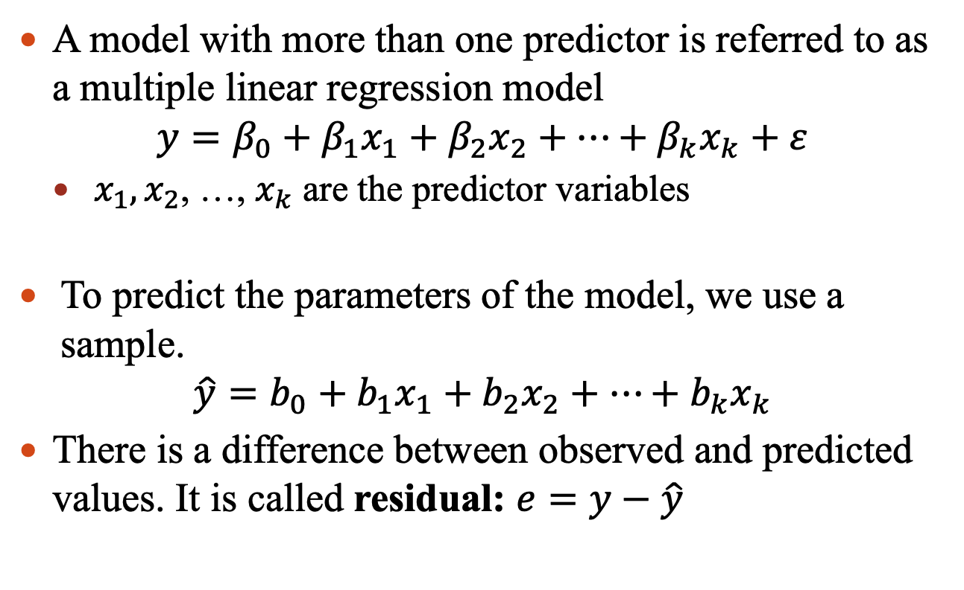
Linear Regression Model
A model with more than one predictor is referred to as a multiple linear regression model
$$y=β_{0}+β_{1}x_{1}+β_{2}x_{2}+…+β_{k}x_{k}+ε$$
$x_{1},x_{2}$, …, $x_{k}$ are the predictor variables
To predict the parameters of the model, we use a sample.
$$\hat{y}=b_{0}+b_{1}x_{1}+b_{2}x_{2}+…+b_{k}x_{k}$$
There is a difference between observed and predicted values. It is called residual: $e=y−\hat{y}$

Slide 5
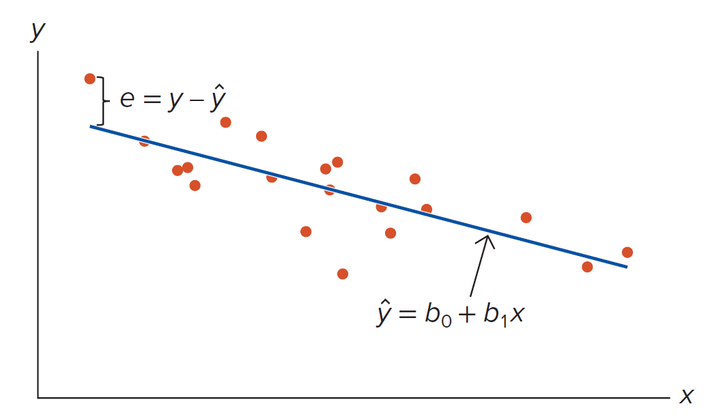
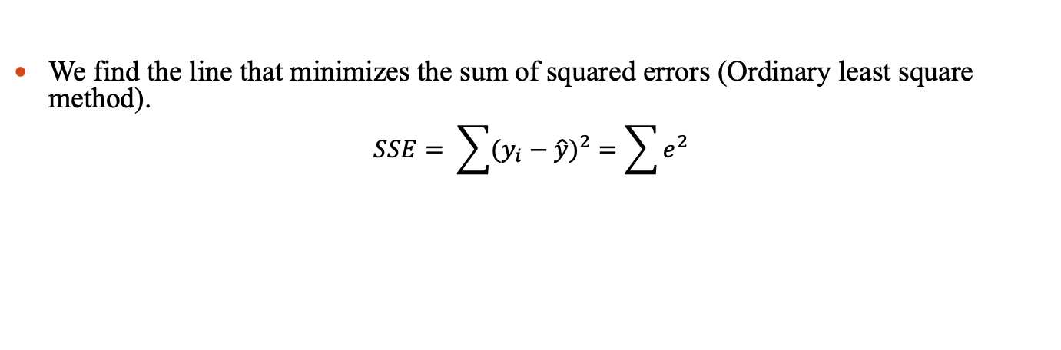
Linear Regression Model
We find the line that minimizes the sum of squared errors (Ordinary least square method).
$$SSE= \sum{{(y_{i}−\hat{y})}^{2}}=\sum{e^{2}}$$

Slide 6
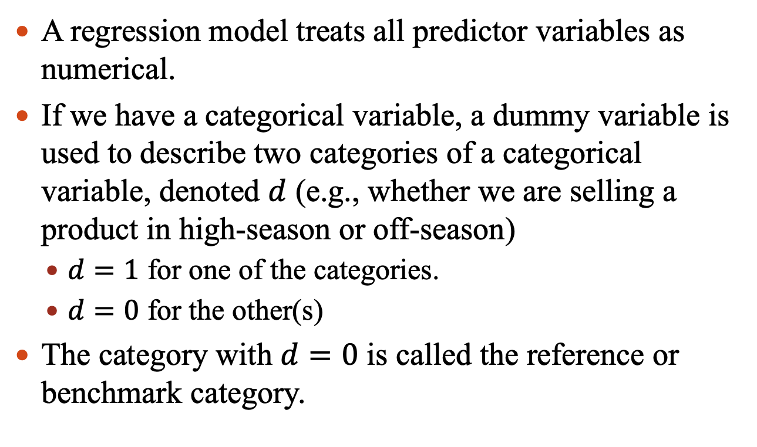
Linear Regression Model
A regression model treats all predictor variables as numerical.
If we have a categorical variable, a dummy variable is used to describe two categories of a categorical variable, denoted $d$ (e.g., whether we are selling a product in high-season or off-season)
$d=1$ for one of the categories.
$d=0$ for the other(s)
The category with $d=0$ is called the reference or benchmark category.

Slide 7
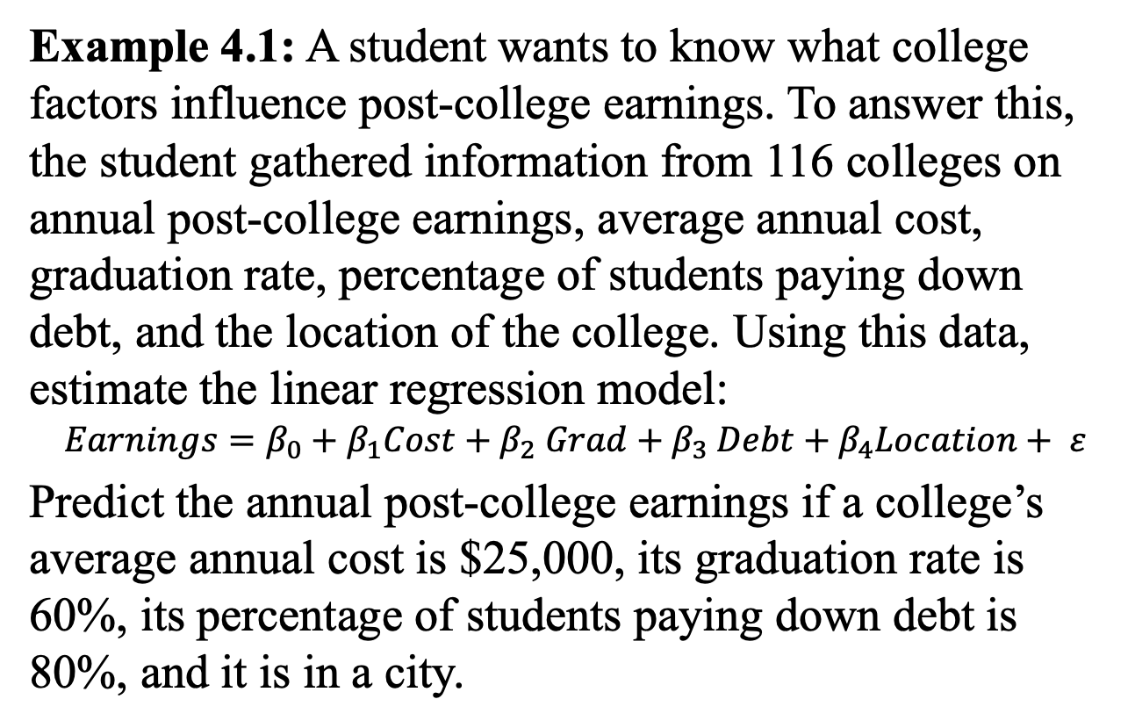
Linear Regression Model
Example 4.1: A student wants to know what college factors influence post-college earnings. To answer this, the student gathered information from 116 colleges on annual post-college earnings, average annual cost, graduation rate, percentage of students paying down debt, and the location of the college. Using this data, estimate the linear regression model:
$$Earnings=β_{0}+β_{1}Cost+β_{2} Grad+β_{3} Debt+β_{4}Location+ ε$$
Predict the annual post-college earnings if a college’s average annual cost is $25,000, its graduation rate is 60%, its percentage of students paying down debt is 80%, and it is in a city.

Slide 8
Linear Regression Model
Solution:
Earnings = 10004.97 + 0.4349 Cost + 178.10 Grad + 141.48 Debt + 2526.79 City
Earnings = 10004.97 + 0.4349 * 25,000 + 178.10 * 60 + 141.48 * 80 + 2526.79 * 1 = 45,408.7991

Slide 9
Linear Regression Model
Example 4.2: The data file “Car_Prices” shows the price, the age, and the milage for 20 used cars.
Estimate the sample regression equation that enables us to predict the price of a car on the basis of its age and mileage.
Predict the price of a five-year-old car with 65,000 miles.

Slide 10
Linear Regression Model
Regression models are known to perform well for making predications.
We should be careful when establishing cause-and-effect relationship using regression models.
Predication are subject to sample variability.
We can find a confidence interval for out prediction.
We find an upper bound and a lower bound within which the response variable is expected to fall with a certain probability, given specific values of the predictor variables.

Slide 11
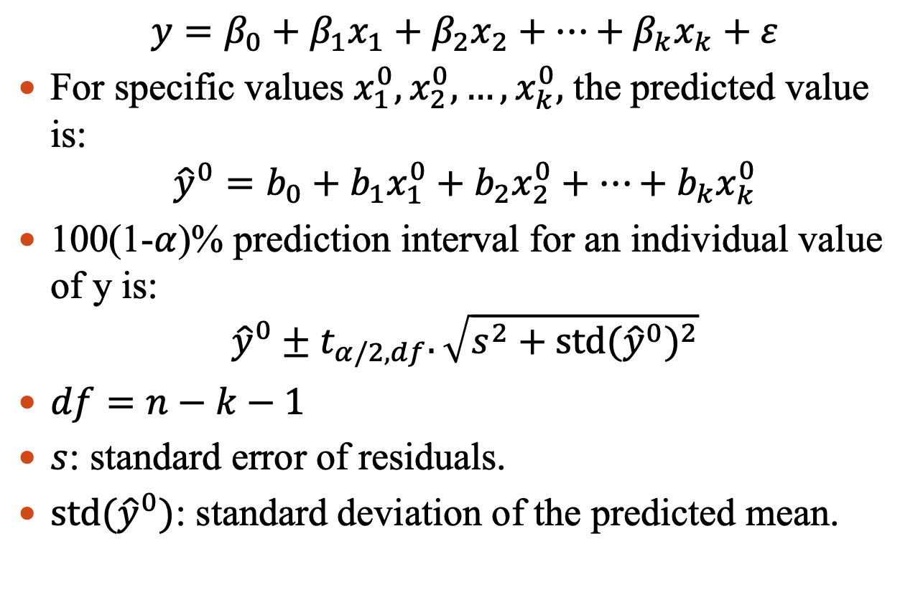
Linear Regression Model
$$y=β_{0}+β_{1}x_{1}+β_{2}x_{2}+…+β_{k}x_{k}+ε$$
For specific values $x_{1}^{0},x_{2}^{0},…,x_{k}^{0},$ the predicted value is:
$${\hat{y}}^{0}=b_{0}+b_{1}x_{1}^{0}+b_{2}x_{2}^{0}+…+b_{k}x_{k}^{0}$$
100(1-$α$)% prediction interval for an individual value of y is:
$${\hat{y}}^{0}±t_{α/2,df}.\sqrt{s^{2}+{\text{std}({\hat{y}}^{0})}^{2}}$$
$df=n−k−1$
$s$: standard error of residuals.
$\text{std}({\hat{y}}^{0})$: standard deviation of the predicted mean.

Slide 12
Linear Regression Model
Example 4.3:
In Example 4.1, Construct the 95% confidence interval for the predicted Earnings if Cost equals $25,000, Grad equals 60, Debt equals 80, and City equals 1.
$$Earnings=β_{0}+β_{1}Cost+β_{2} Grad+β_{3} Debt+β_{4}Location+ ε$$

Slide 13
Linear Regression Model
Example 4.4:
In Example 4.2, Construct the 95% confidence interval for the predicted price if the car is five years old and its mileage is 65,000.

Slide 14
Linear Regression Model
A categorical variable may be defined by more than two categories.
E.g.: The mode of transportation used to commute to work can be described as: Public transportation, driving alone, and carpooling.
We use dummy variables to capture all categories.
We exclude one of the dummy variables from the regression (number of dummy variables = number of categories – 1).
The excluded variable represents the reference category.

Slide 15

Linear Regression Model
A categorical variable may be defined by more than two categories.
E.g.: Mode of transportation used to commute to work can be described by: Public transportation, driving alone, and carpooling.
We use dummy variables to capture all categories.
We exclude one of the dummy variables from the regression (number of dummy variables = number of categories – 1).
The excluded variable represents the reference category.
Example: mode of transportation with three categories:
Public transportation, driving alone, or carpooling.
$d_{1}=1$ for public transportation and 0 otherwise.
$d_{2}=1$ for driving alone and 0 otherwise.
$d_{1}=d_{2}=0$ indicates carpooling.

Slide 16
Linear Regression Model
Example 4.5: A government researcher is analyzing the relationship between retail sales (in $ million) and the gross national product (in $ billion). She wonders whether there are significant differences in retail sales related to the quarters of the year. She collects 10 years of quarterly data.
What are the predicted sales in quarters 1, 2, 3, and 4 if GNP is $18,000?

Slide 17
Linear Regression Model
By simply observing the sample regression equation, we cannot assess how well the predictor variables explain the variation in response variable.
Recall our first example:
We can develop different models:

Slide 18

Linear Regression Model
Goodness-of-fit measures: summarize how well the sample regression equation fits the data.
The standard error of estimate:
Residual is the difference between the observed and predicted value of the response, $e_{i}=y_{i}−\hat{y}$

Slide 19

Linear Regression Model
Goodness-of-fit measures: summarize how well the sample regression equation fits the data.
The standard error of estimate:
Residual is the difference between the observed and predicted value of the response, $e_{i}=y−\hat{y}$

Slide 20
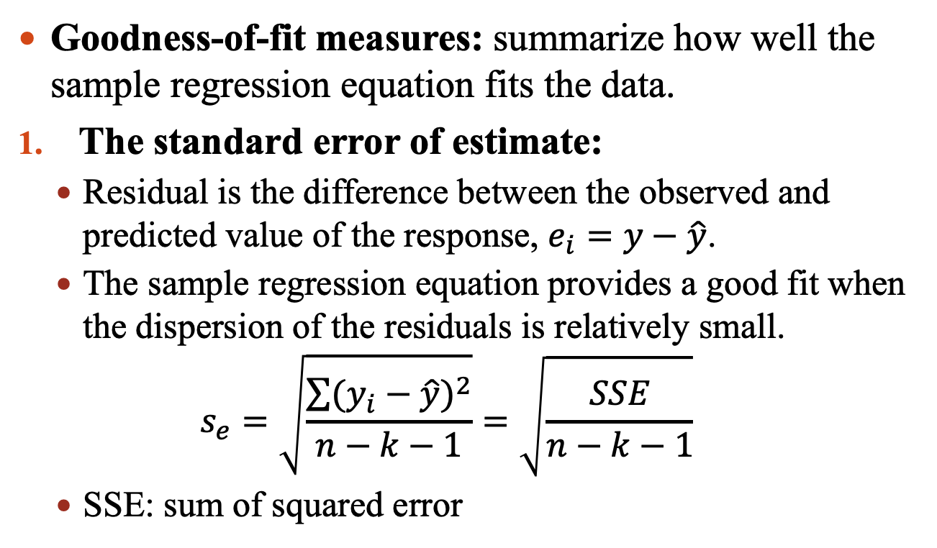
Linear Regression Model
Goodness-of-fit measures: summarize how well the sample regression equation fits the data.
The standard error of estimate:
Residual is the difference between the observed and predicted value of the response, $e_{i}=y−\hat{y}$.
The sample regression equation provides a good fit when the dispersion of the residuals is relatively small.
$$s_{e}=\sqrt{\frac{\sum{{(y_{i}−\hat{y})}^{2}}}{n−k−1}}=\sqrt{\frac{SSE}{n−k−1}}$$
SSE: sum of squared error

Slide 21
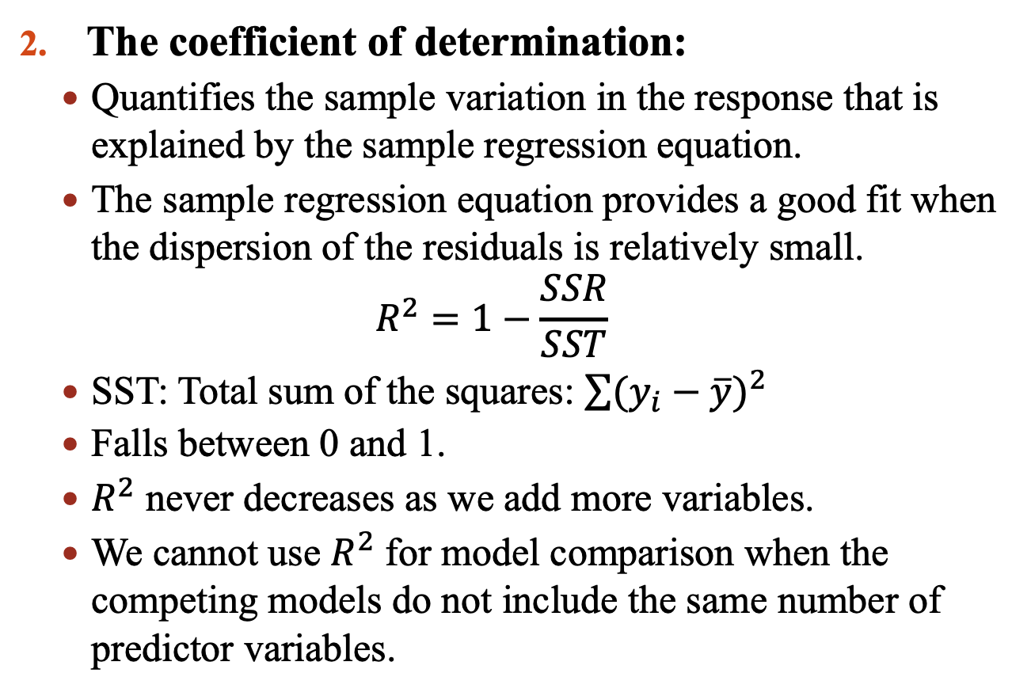
Linear Regression Model
The coefficient of determination:
Quantifies the sample variation in the response that is explained by the sample regression equation.
The sample regression equation provides a good fit when the dispersion of the residuals is relatively small.
$$R^{2}=1−\frac{SSR}{SST}$$
SST: Total sum of the squares: $\sum{{(y_{i}−\overline{y})}^{2}}$
Falls between 0 and 1.
$R^{2}$ never decreases as we add more variables.
We cannot use $R^{2}$ for model comparison when the competing models do not include the same number of predictor variables.

Slide 22
Linear Regression Model
The coefficient of determination:
Quantifies the sample variation in the response that is explained by the sample regression equation.
The sample regression equation provides a good fit when the dispersion of the residuals is relatively small.
$$R^{2}=1−\frac{SSR}{SST}$$
SST: Total sum of the squares: $\sum{{(y_{i}−\overline{y})}^{2}}$
Falls between 0 and 1.
$R^{2}$ never decreases as we add more variables.
We cannot use $R^{2}$ for model comparison when the competing models do not include the same number of predictor variables.

Slide 23
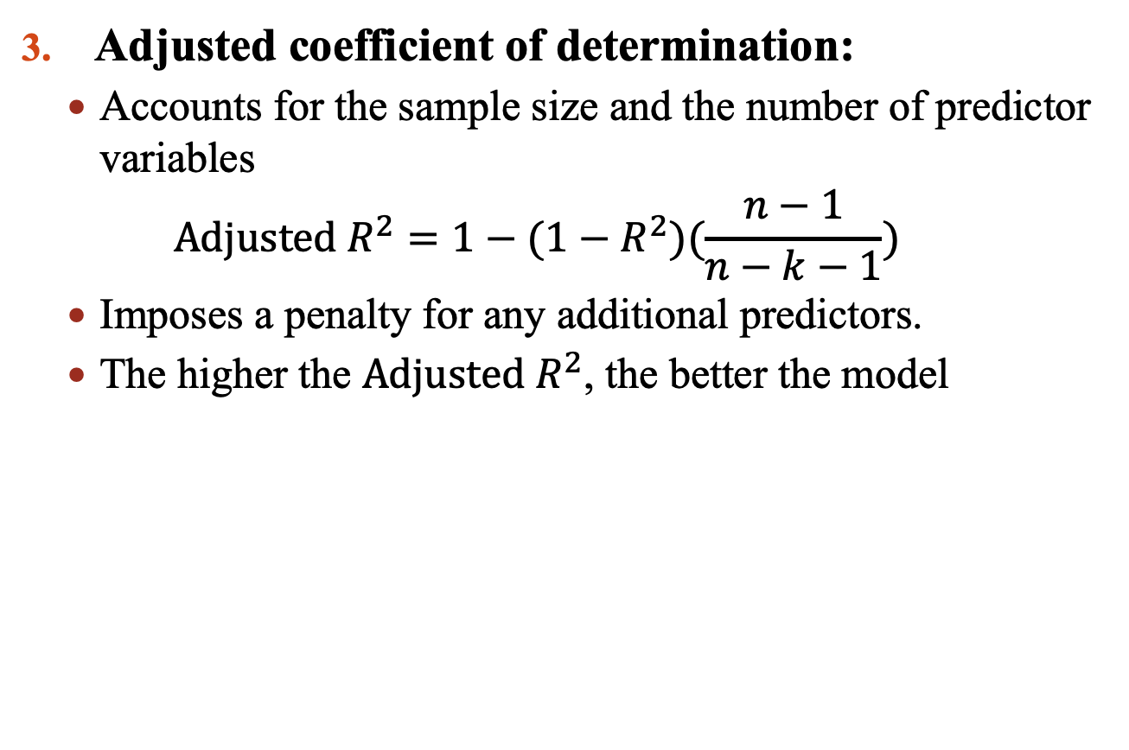
Linear Regression Model
Adjusted coefficient of determination:
Accounts for the sample size and the number of predictor variables
$$\text{Adjusted} R^{2}=1−(1−R^{2})(\frac{n−1}{n−k−1})$$
Imposes a penalty for any additional predictors.
The higher the $\text{Adjusted} R^{2}$, the better the model

Slide 24
Linear Regression Model
Example 4.6: In Example 4.1, which of the following models is the preferred model?

Slide 25
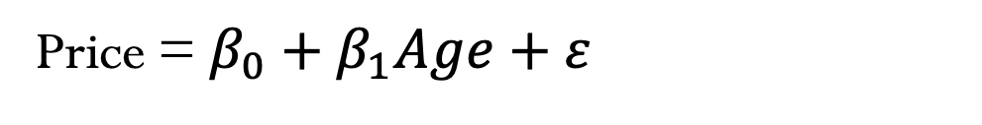
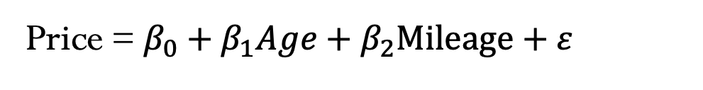
Linear Regression Model
Example 4.7: In Example 4.2, which of the following models is the preferred model?
Price = $β_{0}+β_{1}Age+ε$
Price = $β_{0}+β_{1}Age+β_{2}Mileage+ε$

Slide 26
Cross-Validation
All of the model evaluation measures that we have covered assess predictability in the sample data that was used to build the model.
These measures do not help evaluate how well an estimated model will predict an unseen sample.
It is possible a model performs well with the sample data used for estimation but then performs poorly once a new sample is evaluated (overfitting).

Slide 27
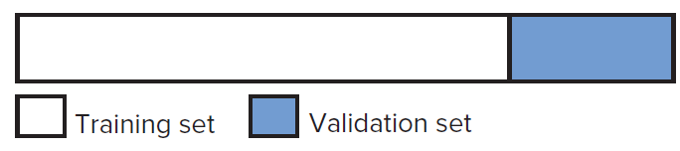
Cross-Validation
We need a measure of the predictive power of a model based on a set of data not used in estimation.
Cross validation is a technique that evaluates predictive models by partitioning the sample.
Training set: use to train the model.
Validation set: use to evaluate/validate the model.
We want the model with a good performance in the training set to also have the best performance in the validation set.

Slide 28
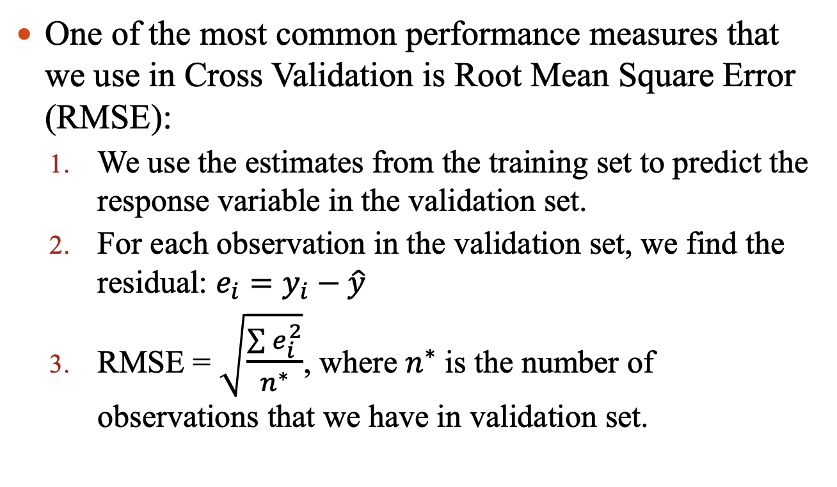
Cross-Validation
One of the most common performance measures that we use in Cross Validation is Root Mean Square Error (RMSE):
We use the estimates from the training set to predict the response variable in the validation set.
For each observation in the validation set, we find the residual: $e_{i}=y_{i}−\hat{y}$
RMSE = $\sqrt{\frac{\sum{e_{i}^{2}}}{n^{∗}}}$, where $n^{∗}$ is the number of observations that we have in validation set.

Slide 29
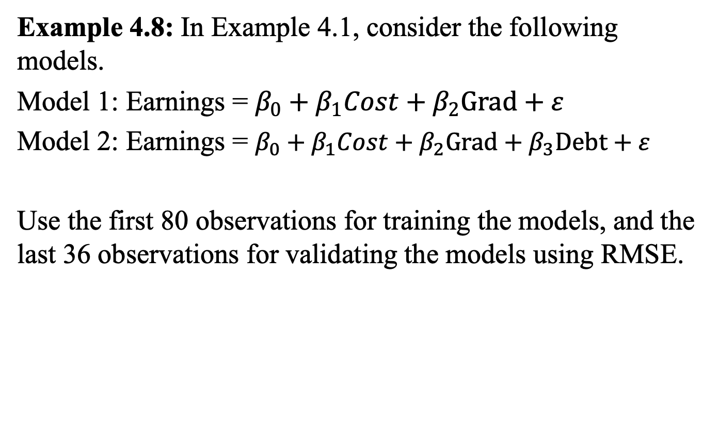
Cross-Validation
Example 4.8: In Example 4.1, consider the following models.
Model 1: Earnings = $β_{0}+β_{1}Cost+β_{2}Grad+ε$
Model 2: Earnings = $β_{0}+β_{1}Cost+β_{2}Grad+β_{3}Debt+ε$
Use the first 80 observations for training the models, and the last 36 observations for validating the models using RMSE.

Slide 30
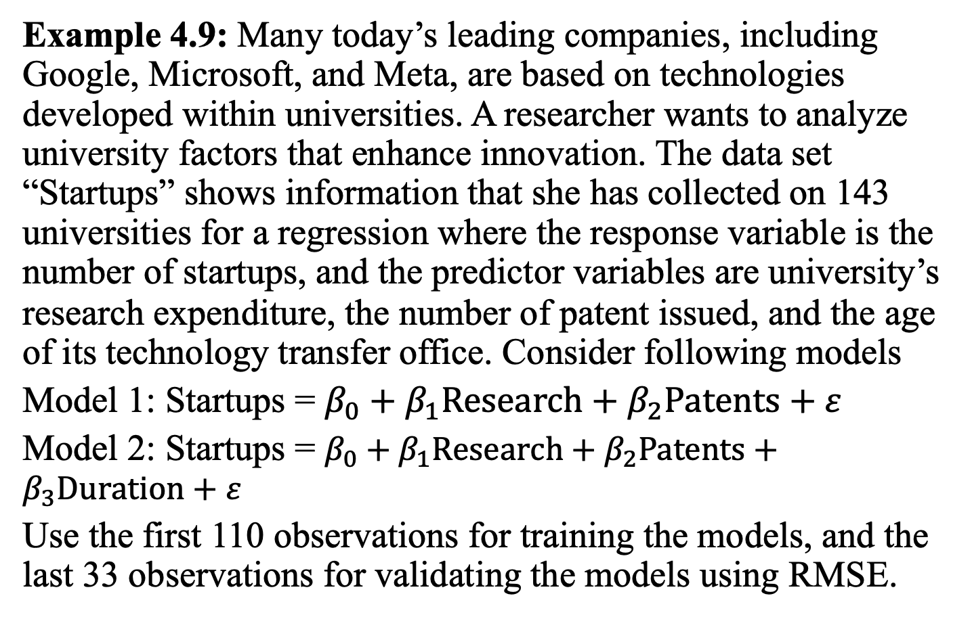
Cross-Validation
Example 4.9: Many today’s leading companies, including Google, Microsoft, and Meta, are based on technologies developed within universities. A researcher wants to analyze university factors that enhance innovation. The data set “Startups” shows information that she has collected on 143 universities for a regression where the response variable is the number of startups, and the predictor variables are university’s research expenditure, the number of patent issued, and the age of its technology transfer office. Consider following models
Model 1: Startups = $β_{0}+β_{1}Research+β_{2}Patents+ε$
Model 2: Startups = $β_{0}+β_{1}Research+β_{2}Patents+β_{3}Duration+ε$
Use the first 110 observations for training the models, and the last 33 observations for validating the models using RMSE.

Slide 31
Logistic Regression
We have considered the case where dummy (binary) variables are used as predictor variables.
Response variables can be binary as well.
E.g.: A telecommunication company wants to identify which customers are likely to cancel their service in the next period (inputs: monthly bill amount, contract type, length of time as a customer, usage pattern, etc.).
E.g.: Whether or not to approve a loan

Slide 32

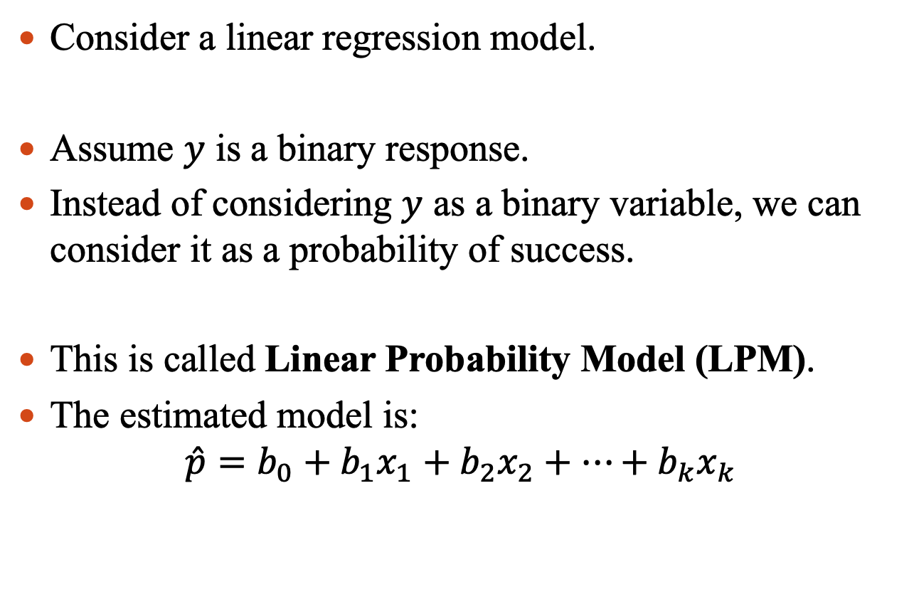

Logistic Regression
Consider a linear regression model.
Assume $y$ is a binary response.
Instead of considering $y$ as a binary variable, we can consider it as a probability of success.
This is called Linear Probability Model (LPM).
The estimated model is:
$$\hat{p}=b_{0}+b_{1}x_{1}+b_{2}x_{2}+…+b_{k}x_{k}$$
$$y=β_{0}+β_{1}x_{1}+β_{2}x_{2}+…+β_{k}x_{k}+ε$$
$$p=β_{0}+β_{1}x_{1}+β_{2}x_{2}+…+β_{k}x_{k}+ε$$

Slide 33
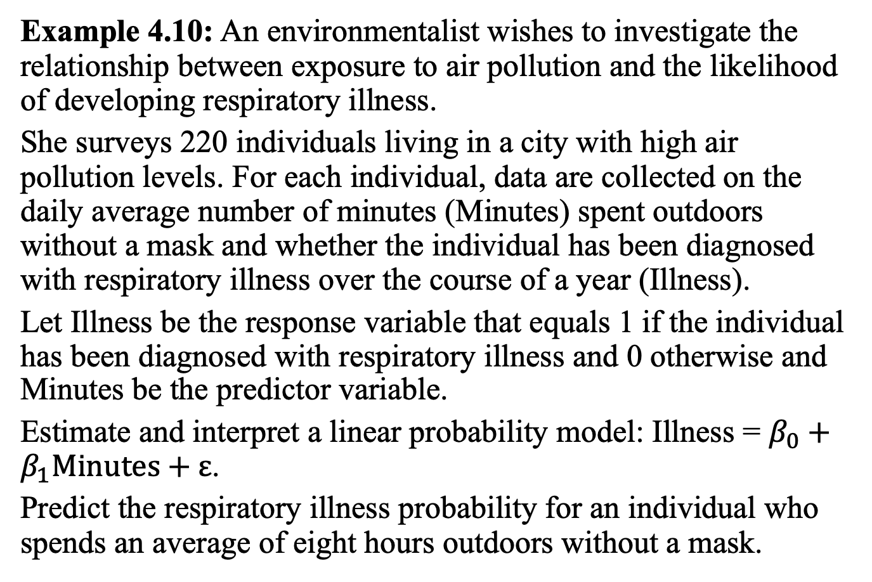
Logistic Regression
Example 4.10: An environmentalist wishes to investigate the relationship between exposure to air pollution and the likelihood of developing respiratory illness.
She surveys 220 individuals living in a city with high air pollution levels. For each individual, data are collected on the daily average number of minutes (Minutes) spent outdoors without a mask and whether the individual has been diagnosed with respiratory illness over the course of a year (Illness).
Let Illness be the response variable that equals 1 if the individual has been diagnosed with respiratory illness and 0 otherwise and Minutes be the predictor variable.
Estimate and interpret a linear probability model: Illness = $β_{0}+β_{1}\text{Minutes}\text{ + }ε$.
Predict the respiratory illness probability for an individual who spends an average of eight hours outdoors without a mask.

Slide 34
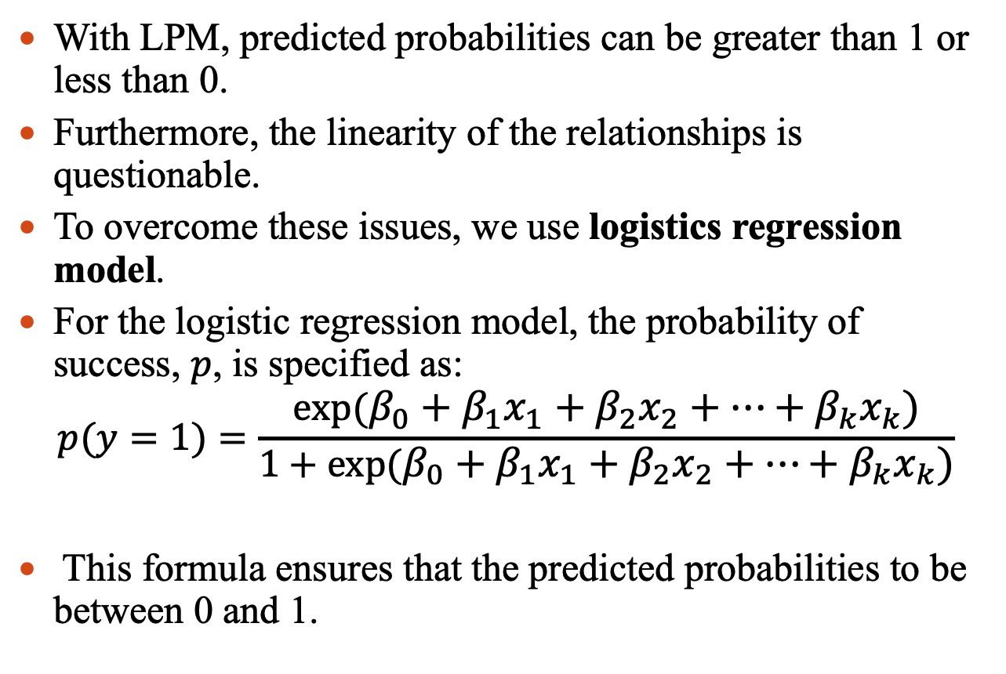
Logistic Regression
With LPM, predicted probabilities can be greater than 1 or less than 0.
Furthermore, the linearity of the relationships is questionable.
To overcome these issues, we use logistics regression model.
For the logistic regression model, the probability of success, $p$, is specified as:
$$p(y=1)=\frac{exp⁡(β_{0}+β_{1}x_{1}+β_{2}x_{2}+…+β_{k}x_{k})}{1+exp⁡(β_{0}+β_{1}x_{1}+β_{2}x_{2}+…+β_{k}x_{k})}$$
This formula ensures that the predicted probabilities to be between 0 and 1.

Slide 35
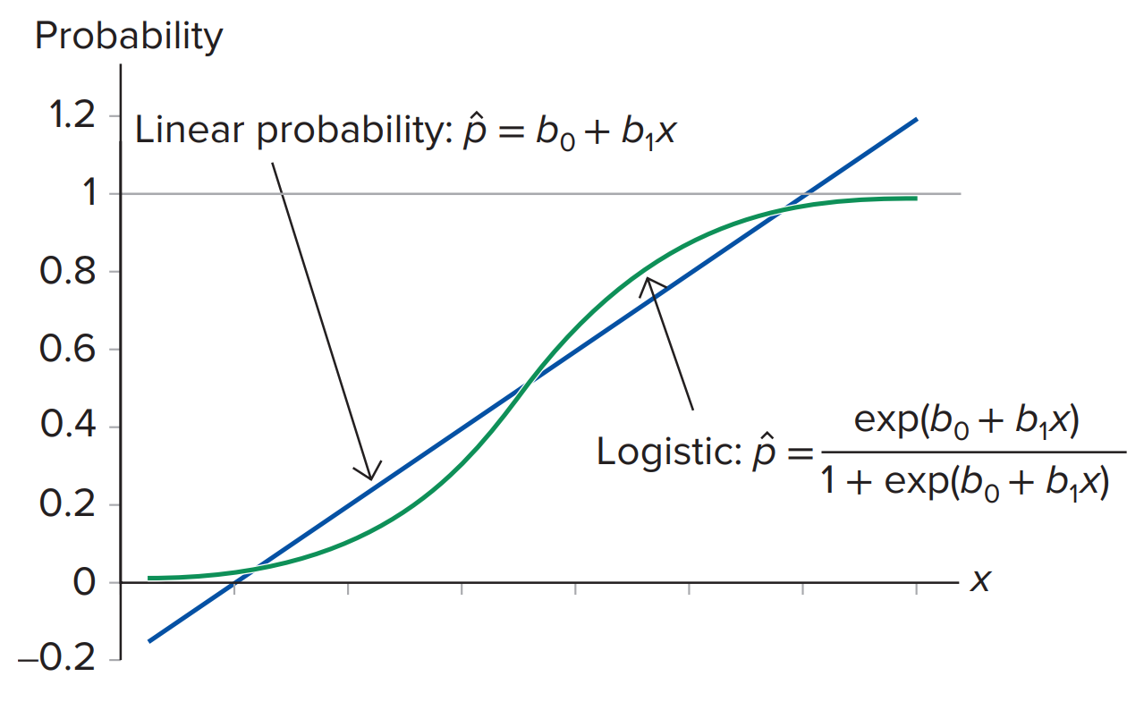
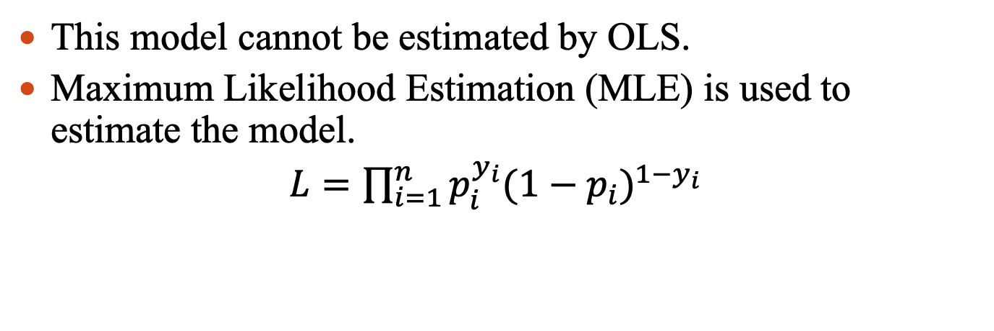
Logistic Regression
This model cannot be estimated by OLS.
Maximum Likelihood Estimation (MLE) is used to estimate the model.
$L=\prod_{i=1}^{n}{p_{i}^{y_{i}}{(1−p_{i})}^{1−y_{i}}}$

Slide 36
Logistic Regression
Example 4.11: Revisit Example 4.10.
Estimate and interpret the logistic regression model using Illness as the response variable and Minutes as the predictor variable.
Predict the respiratory illness probability for an individual who spends an average of eight hours outdoors without a mask.

Slide 37
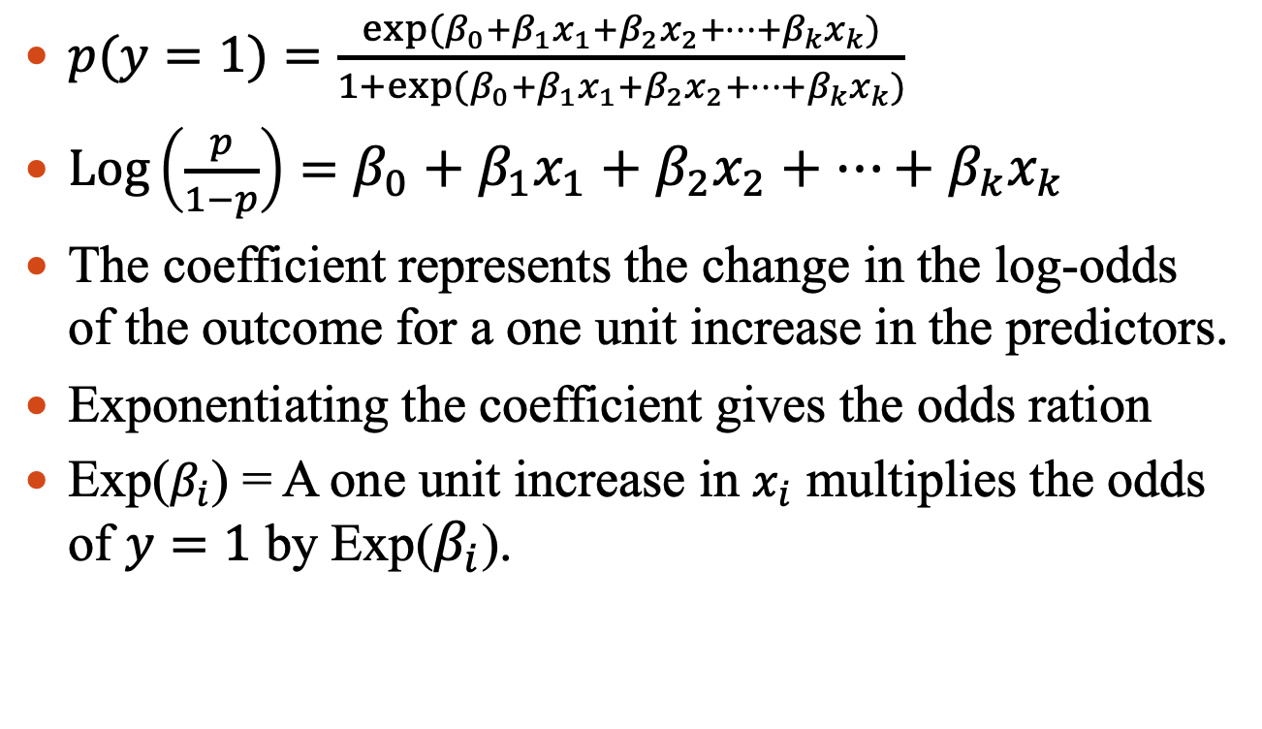
Logistic Regression
$p(y=1)=\frac{exp⁡(β_{0}+β_{1}x_{1}+β_{2}x_{2}+…+β_{k}x_{k})}{1+exp⁡(β_{0}+β_{1}x_{1}+β_{2}x_{2}+…+β_{k}x_{k})}$
$\text{Log}\left(\frac{p}{1−p}\right)=β_{0}+β_{1}x_{1}+β_{2}x_{2}+…+β_{k}x_{k}$
The coefficient represents the change in the log-odds of the outcome for a one unit increase in the predictors.
Exponentiating the coefficient gives the odds ration
Exp($β_{i}$) = A one unit increase in $x_{i}$ multiplies the odds of $y=1$ by Exp($β_{i}$).

Slide 38
Logistic Regression
Example 4.12: The chartered financial analyst (CFA) designation is the de facto professional certification for the financial industry. Historically, the pass rate is higher for those with work experience and a good college GPA. The data file “CFA” includes information on 263 current employees who took the CFA Level I exam, including the employee’s success on the exam (1 for pass, 0 for fail), the employee’s college GPA, and years of work experience.
Estimate the logistic regression model to predict the probability of passing the CFA Level I exam for a candidate with a college GPA of 3.80 and five years of experience.

Slide 39
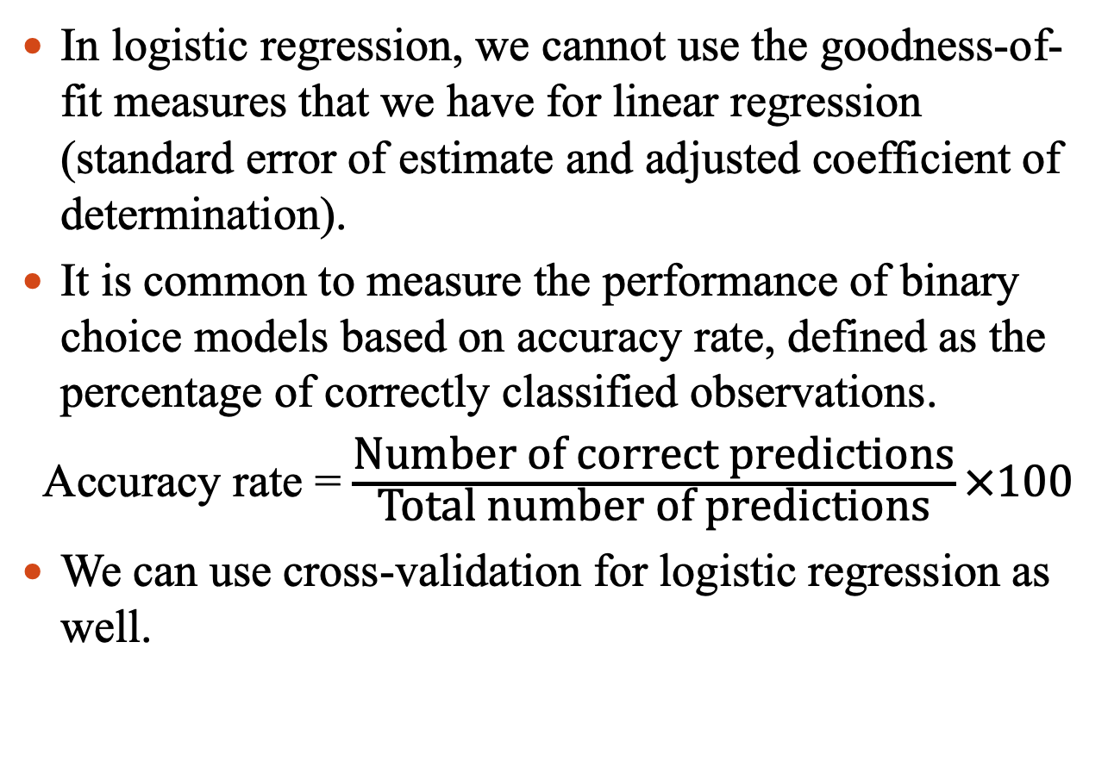
Logistic Regression
In logistic regression, we cannot use the goodness-of-fit measures that we have for linear regression (standard error of estimate and adjusted coefficient of determination).
It is common to measure the performance of binary choice models based on accuracy rate, defined as the percentage of correctly classified observations.
Accuracy rate = $\frac{\text{Number} \text{of} \text{correct} \text{predictions}}{\text{Total} \text{number} \text{of} \text{predictions}}×100$
We can use cross-validation for logistic regression as well.

Slide 40
Logistic Regression
Example 4.13: A company wants to implement an effective spam detection system on the company’s email server. The company analyzes a sample of 500 spam and legitimate emails with the following variables: spam (1 if spam, 0 otherwise), the number of recipients, the number of hyperlinks, and the number of characters in the message. Develop a logistic regression model for spam detection and assess the performance of the model using 375 observations for training and the rest for validation.

Slide 41
Logistic Regression
Example 4.14: Consider the dataset “Subscription” to predict subscription (Subscribe = 1 if the customer subscribes, 0 otherwise). Predictor variables include the percentage of discount (Discount) and the customer’s age (Age) and marital status (MaritalStatus). Use cross-validation to calculate the accuracy of the model using the first 200 observations for training and the remaining 100 observations for validation.

